Slide 1
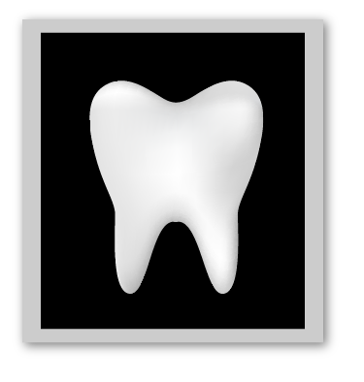
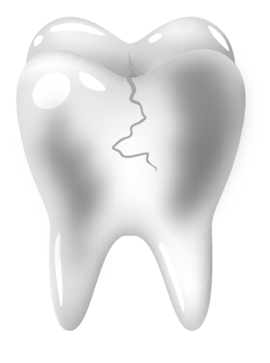

Slide 3
DELTA DENTAL PPO PLAN
 | In-network | Out-of-network
Annual Deductible | $50/individual $150/family | $50/individual $150/family
Annual Benefit Maximum | $2,000/calendar year | $2,000/calendar year
Covered Services
Diagnostic & Preventive Care | Plan pays 100% No deductible | Plan pays 100% No deductible
Basic Care | Plan pays 90% | Plan pays 80%
Major Care | Plan pays 60% | Plan pays 50%
Orthodontic Treatment (adults and children) | Plan pays 50% Benefits limited to $2,000/lifetime per individual | Plan pays 50% Benefits limited to $2,000/lifetime per individual

