Slide 1
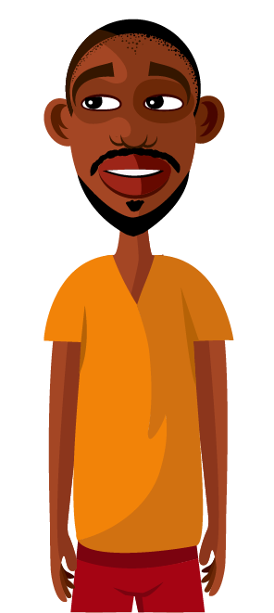
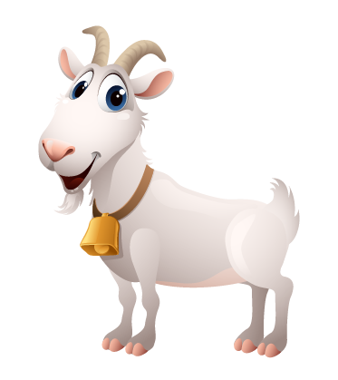
Water – Josia’s Goats
Grade 7, 2a, 09

Slide 2
In this lesson you will …
read the story ‘Josia’s Goats’
discuss the story in detail including the causes and consequences of the polluted water
discuss the effect of water pollution on people
suggest ways to prevent water pollution

Slide 3
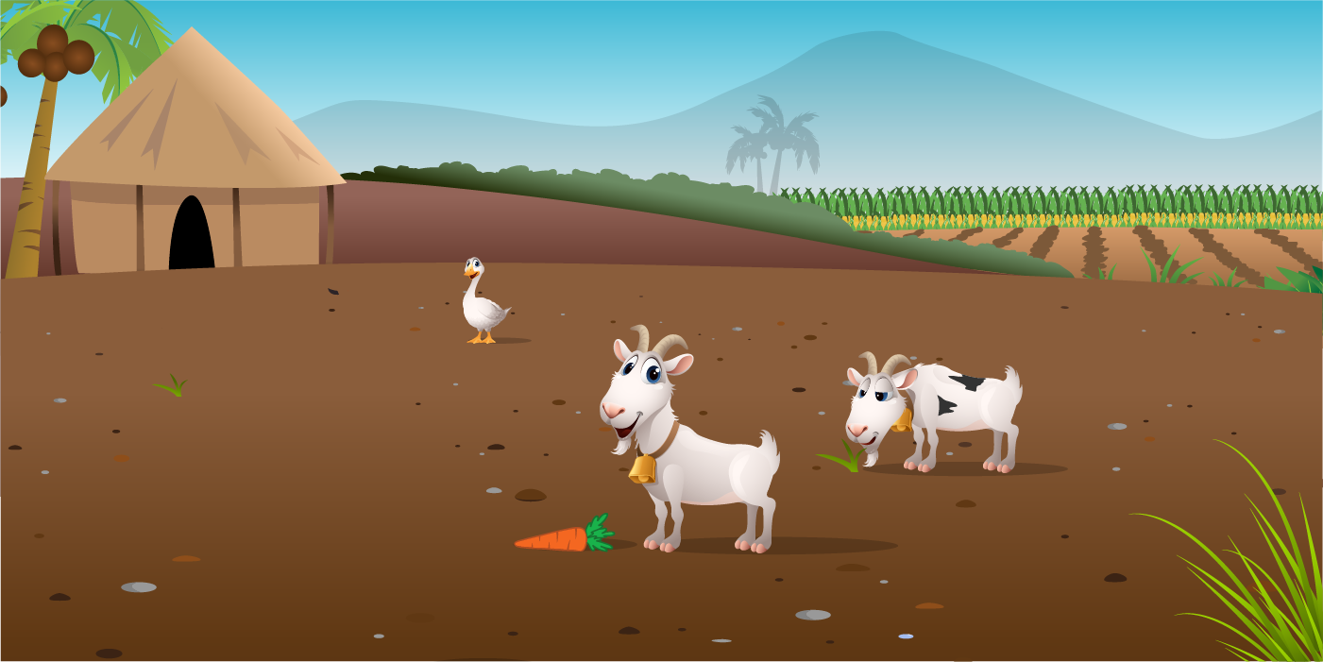
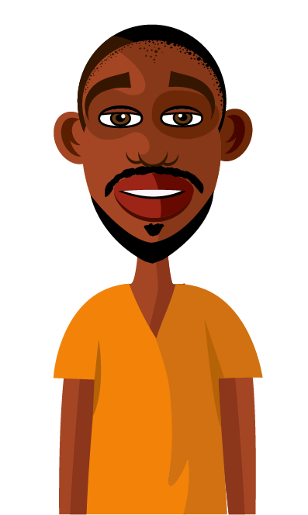
The Story of Josia’s Goats
Notes:
NOTE: I used the font “Old English text” in the scroll above. I have included the font in the Artwork folder.
(you can install it in your system “fonts” folder, then it will work)

Slide 4
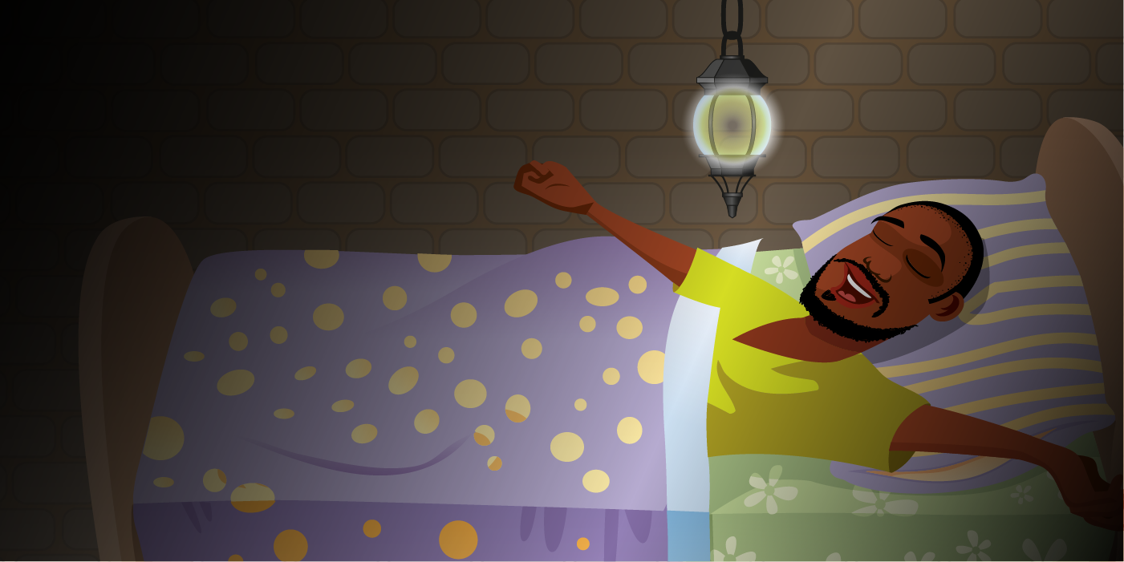
Farming is not an easy way of life, but I like it!
It was early in the morning, before the sun was even showing above the horizon, but Josia knew it was time to get up and get dressed. This day was like every other, a day that started at sunrise and ended at sunset.

Slide 5
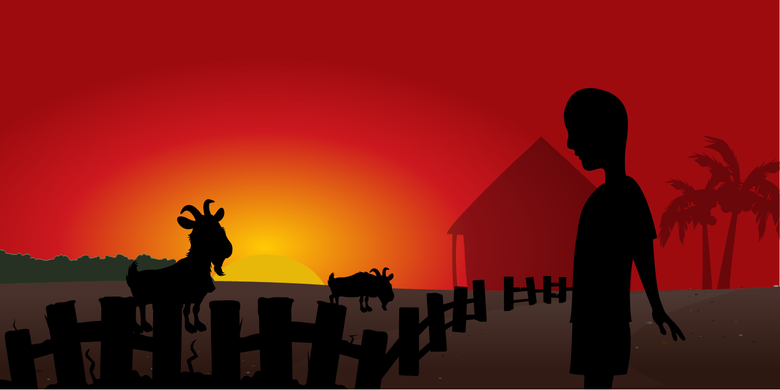
By the time Josia reached the fenced area, which kept his goats safe during the night, the sun had made its way up above the line of the trees.

Slide 6
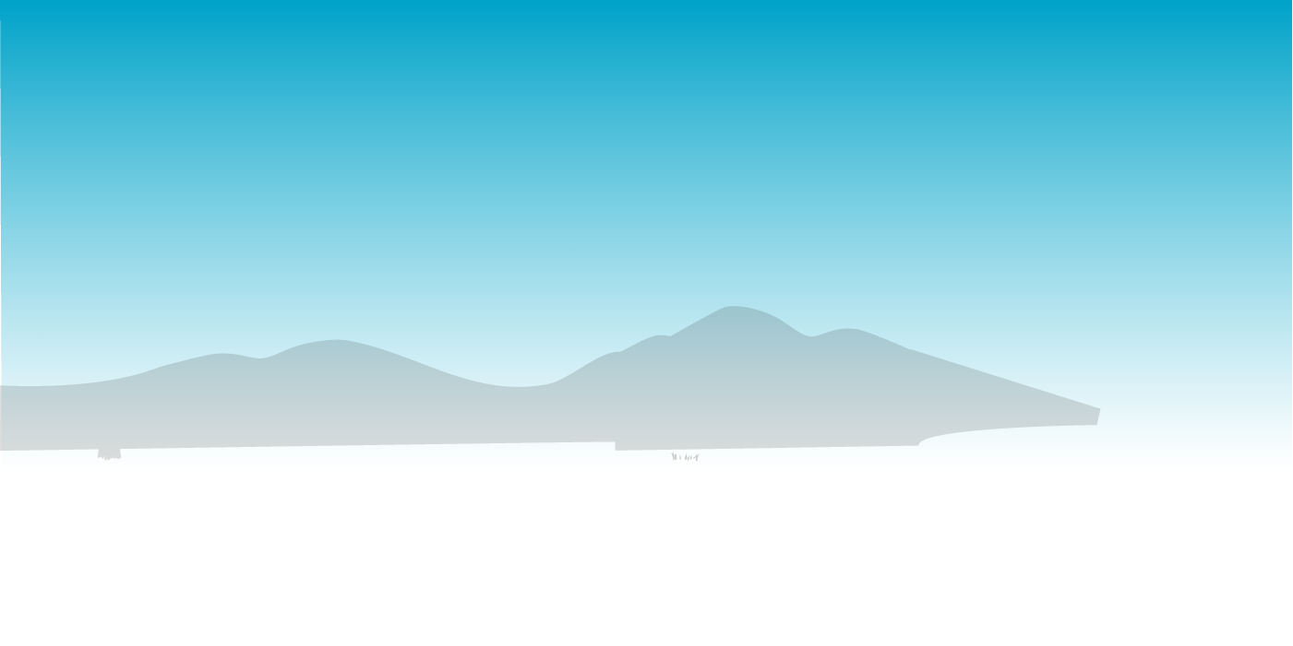
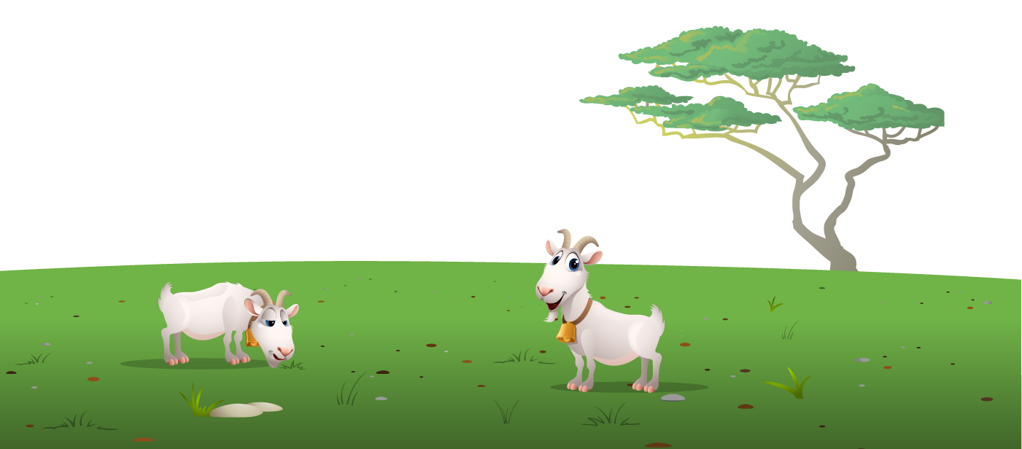
Josia watched as his goats grew fat and he smiled to himself, thinking about what price they would fetch when he sold them at the market in a month’s time. After some time, when the goats had filled their bellies with grass it was time to take them to the watering hole to drink.
With a skip and a hop Josia lead his goats out through the gate and down the long track to the open area, where his goats would graze for the morning. He always loved this time of day; the birds were singing and it felt peaceful.

Slide 7
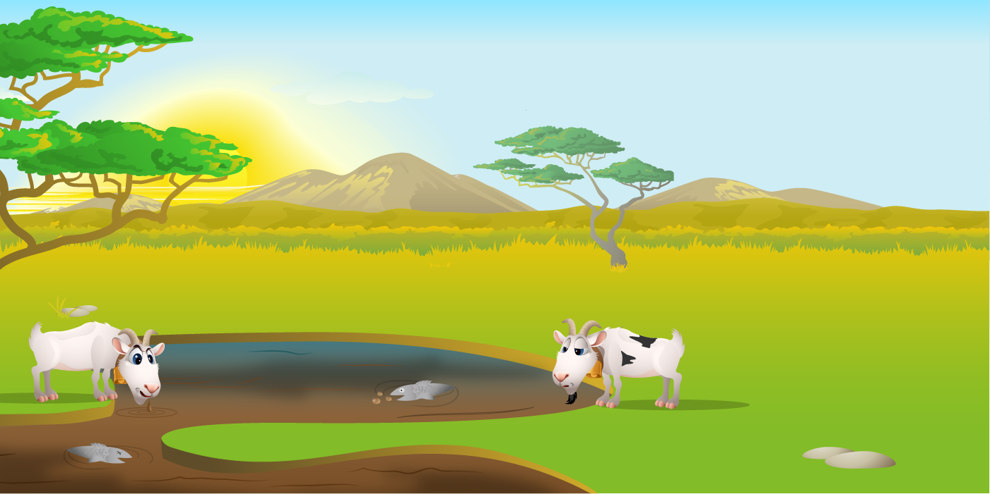
In some parts, the surface of the water was shiny and black and the water was browner that it usually was. He soon forgot about it though when he saw two fish floating on the surface, happy that he wouldn’t have to try very hard to catch his dinner today.
The watering hole never ran dry as it had a continuous supply of water from the nearby river. The water was always fresh and clean and Josia loved to fish here. But today, when he walked up to the water he saw something he had never seen before.
?

Slide 8
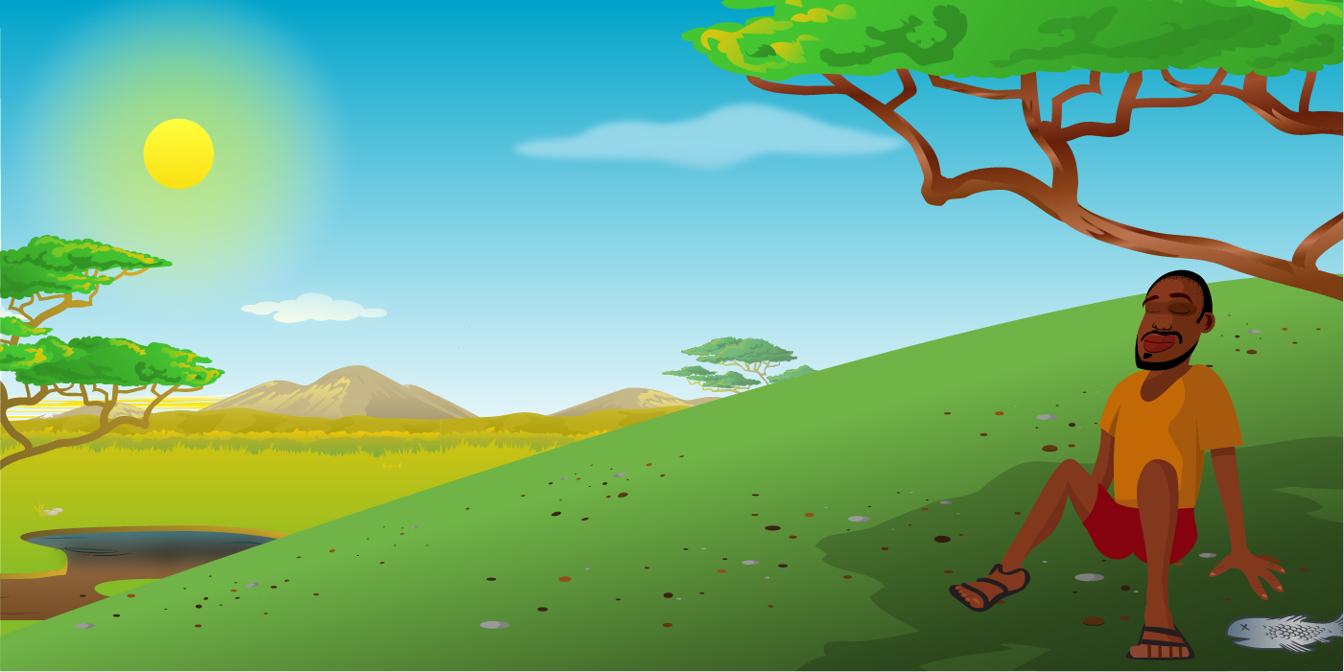
“It must have been the rain we had last night, stirred up the bottom a bit,” Josia said to himself. “Nothing to worry about, I’m sure.
Come on you troublesome animals, drink up!” Josia said to his goats affectionately. He rested under the shade of the big tree and he laid his two fish out in the sun to dry.

Slide 9
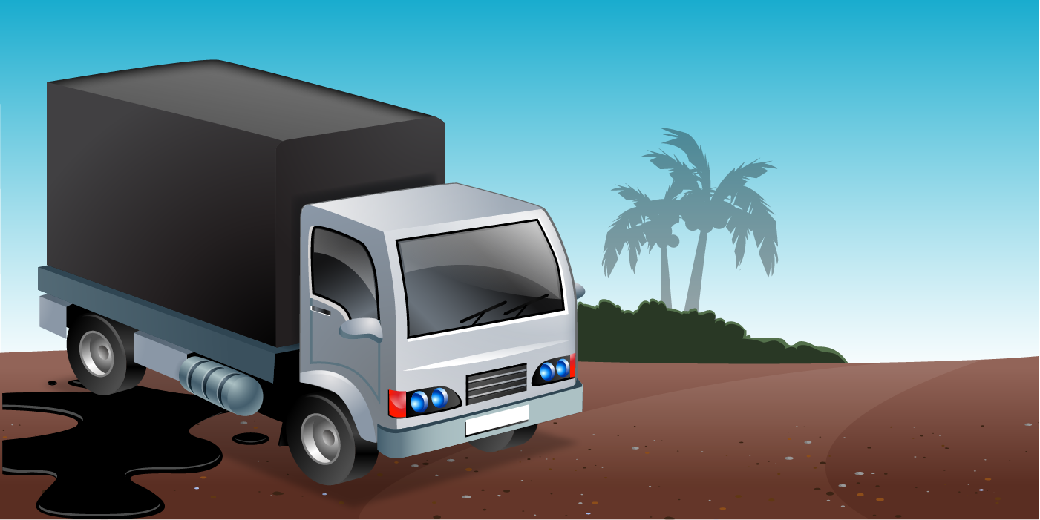
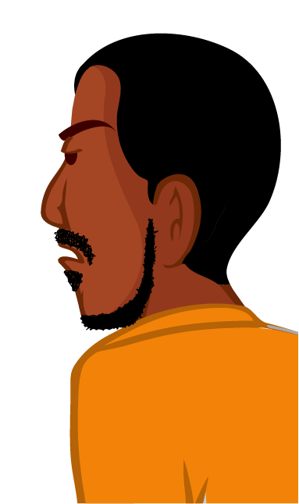
Josia woke with a start to the sound of a noisy engine. Feeling puzzled he rounded up his herd and got on his way. As he got into the clearing, he saw a big truck, dirty and leaking oil everywhere. It seemed as if it was on its way to the river.
“I wonder what that machine is doing.” Josia thought to himself.
MineCo

Slide 10
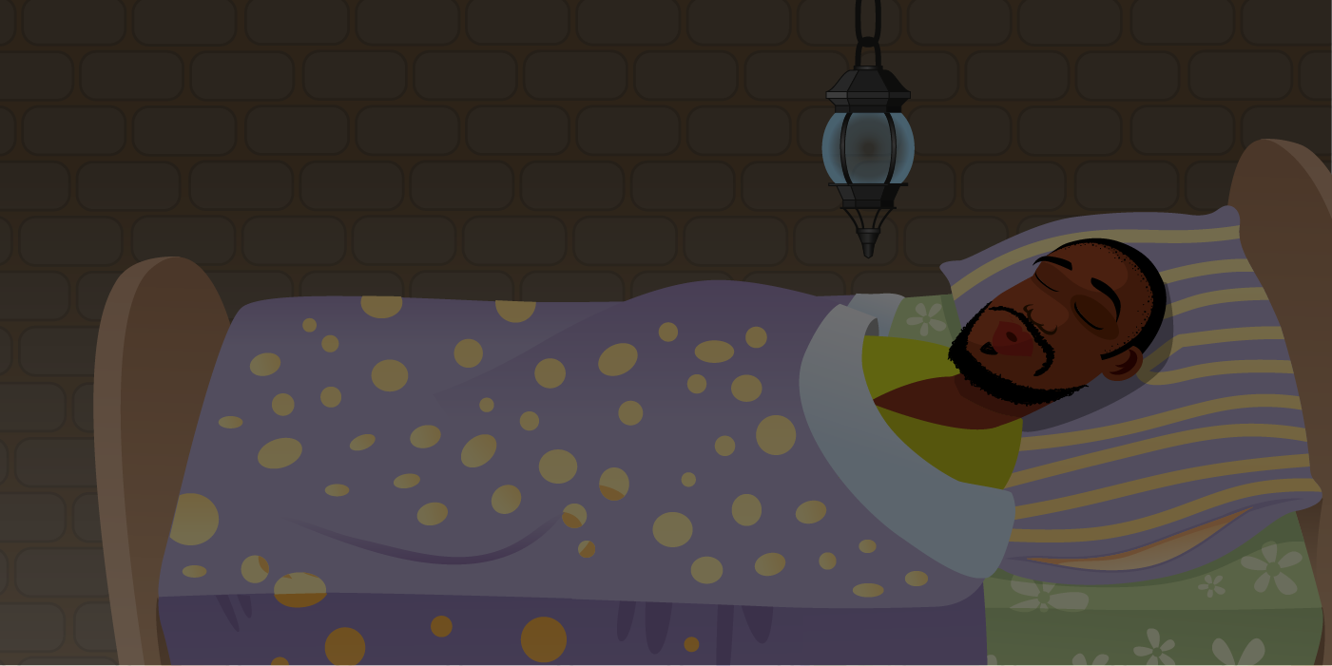
When he got home he put the goats back in their fenced area and worked hard until the sun went down. After his dinner of fish and nshima, Josia fell into a deep sleep.
Zzzzzzzzzz….

Slide 11
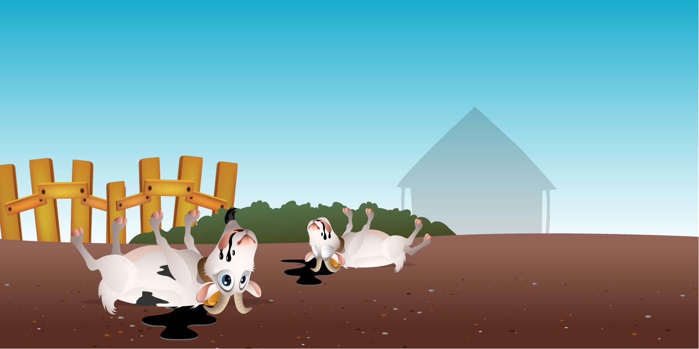
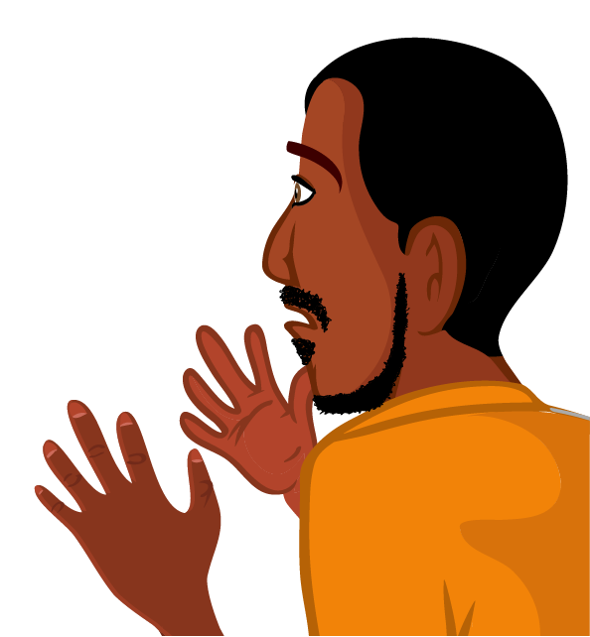
In the morning Josia woke with a very bad stomach ache and he could hear a lot of noise coming from his goats. “What’s wrong with these creatures?” Josia cried.
As he approached the fence he saw three of his goats lying on the floor, kicking and coughing up a horrible shiny black liquid. He ran quickly to get help from Farmer Folami.

Slide 12
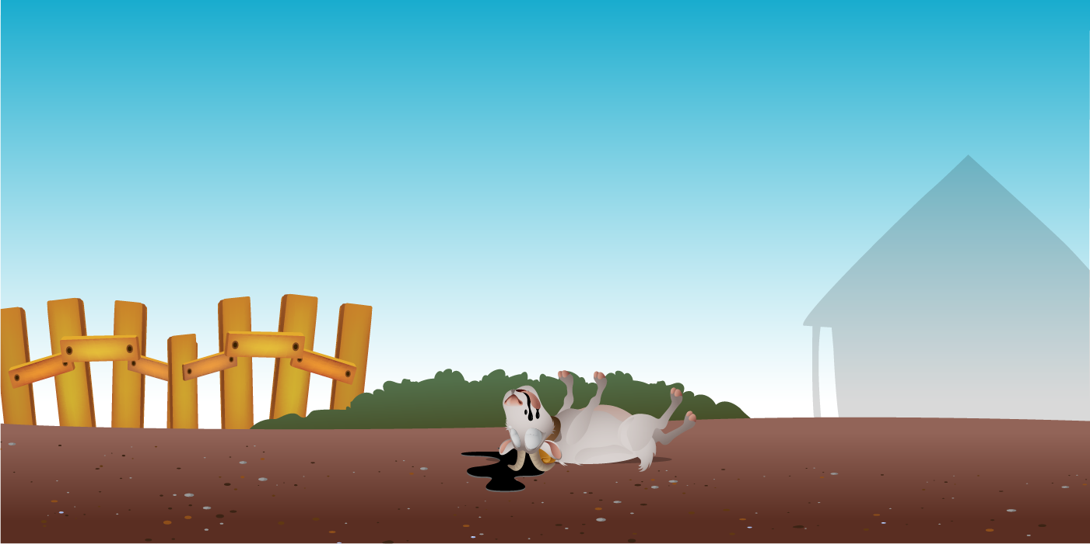
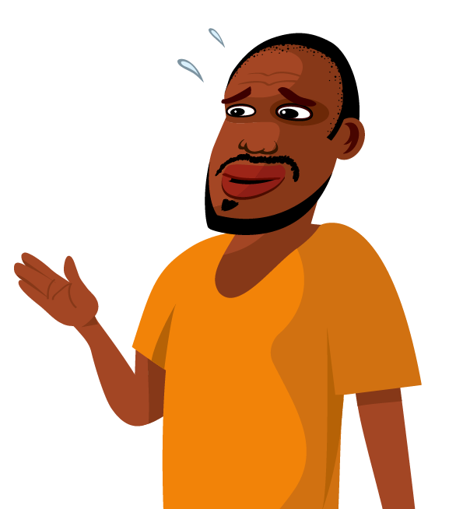
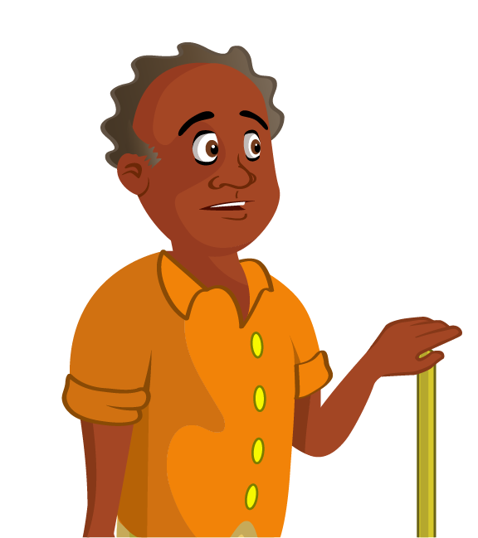
“It must be that watering hole, down near the Shibenze River!” cried Josia.
By lunch time, Josia had lost four of his goats and two of farmer Folami’s cows had died too.
“My cattle are suffering with the same problem, it’s got to be something in the drinking water,” Farmer Folami said to Josia.

Slide 13
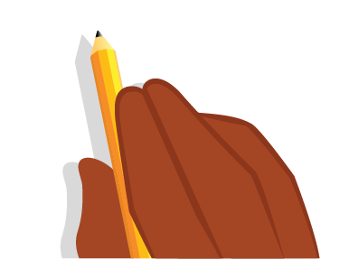
To be
continued…

Slide 14
Can someone in the class describe to us the story of Josia’s goats?
Can anyone else re-tell the story of Josia’s Goats?

Slide 15
What did you notice about the way our two volunteers re-told the story of Josia’s Goats? Did our two volunteers say the same things? Did they leave out any information? Did they use the same words? What part of the story did they tell us about? Did they tell us the most important information?

Slide 16
Excellent work!
These students demonstrated for us something called paraphrasing!
When we tell about a story or piece of information in our own words it is called paraphrasing. It is a very important skill to learn, especially when writing in English, but there a few important rules to follow if you want to be good at it.

Slide 17
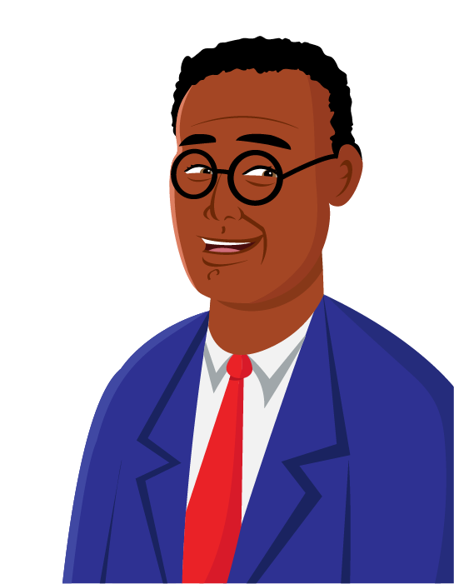
Paraphrasing Perfectly…
It will usually be shorter than the original story or piece of information, with less detail.
First we look for the main idea
We try to change the words and the order of the words
We also try to change the order of the sentence or paragraph
And we aim to write about it in a different way
Remember in order to paraphrase we must put the information into our own words
Paraphrasing perfectly!

Slide 18
Paraphrase:
Josia got up and put his clothes on before the sun had risen. His days began when the sun rose and ended when the sun set. What do you notice about the second paragraph?
Is the order of the paragraph the same? What words have I changed to make it different?
Take a look at this example of paraphrasing… Original :
It was early in the morning, before the sun was even showing above the horizon but Josia knew it was time to get up and get dressed. This day was like every other, a day which started at sunrise and ended at sunset.

Slide 19
Your turn now! Discuss this paragraph with a partner. Can you paraphrase it?
With a skip and a hop Josia lead his goats out through the gate and down the long track to the open area, where his goats would graze for the morning. He always loved this time of day; the birds were singing and it felt peaceful.

Slide 20
Try this one on your own.
Write down your paraphrase in your exercise book.
Josia watched as his goats grew fat and he smiled to himself, thinking about what price they would fetch when he sold them at the market in a month’s time.
After some time, when the goats had filled their bellies with grass it was time to take them to the watering hole to drink.
Remember – you must not copy what is already written here! You must put it into your own words.

Slide 21
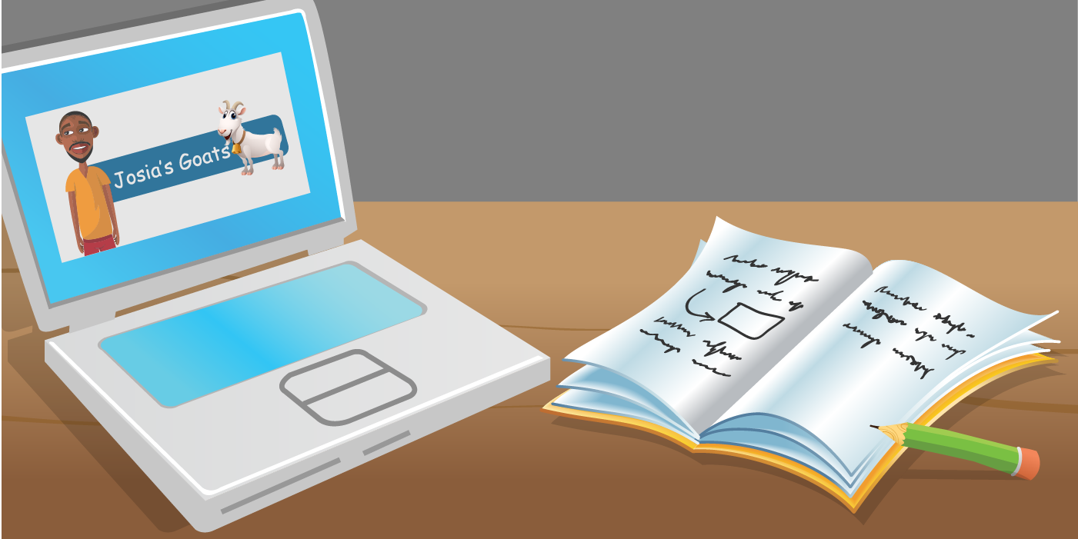
Extension Activity:
Use the computers to read the story Josia’s Goats again. Choose a different paragraph from the story to paraphrase. Write your version of this paragraph into your exercise books.

Slide 22
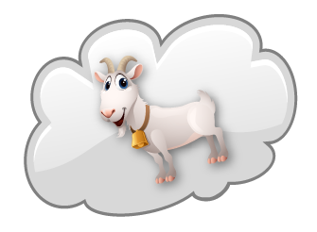
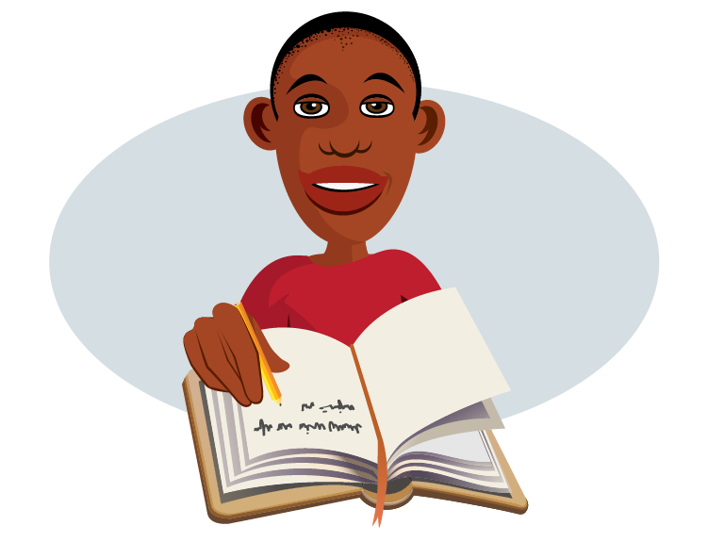
In this lesson, you have…
• read the story ‘Josia’s Goats’
• discussed the story in detail including the causes and consequences of the polluted water
• discussed the effect of water pollution on people
• suggested ways to prevent water pollution

